Slide 1


Presentation Title
Rest API Testing using Rest Assured
Your company information
Sarower Ahmmed

Slide 2
Web services testing means- testing middle end/ webserver.
Language of middle end-
Xml
JSON

Slide 3
Web service testing tools
SoapUI = most popular for web service testing
TestMaker
WebInject
SOAPSonar
wizdl
Stylus Studio
TestingWhiz
SOAtest
Jmeter = popular for performance testing
Storm
Postman = most popular for API testing
vRest
HttpMaster
Runscope
Rapise
LoadUI NG Pro

Slide 4
Web service and API with JAVA
Eclipse
rest-assured Jar file
Selenium- java jar file
Testng/junit/java methods

Slide 5
Which language used in web services testing?
SOAP based web service /API :: Xml
REST based web service /API :: JSON
Which protocol used in web services or API testing ?
HTTP protocol

Slide 6

Web services
Def: Communicate or data transfer- without/bypass internal structure.
Two approach:
SOAP (Simple Object Access Protocol) use xml
REST (Representational State Transfer architecture) json

Slide 7
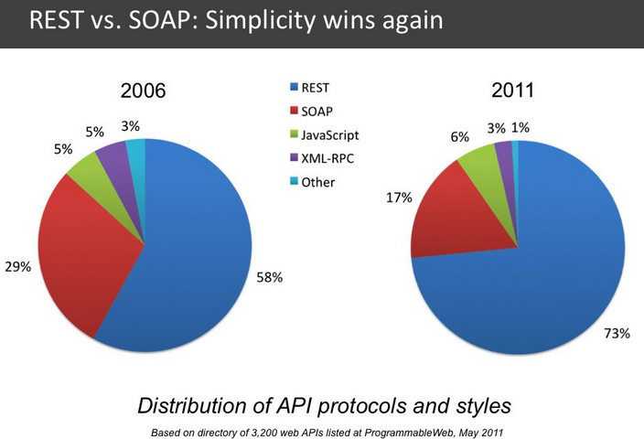
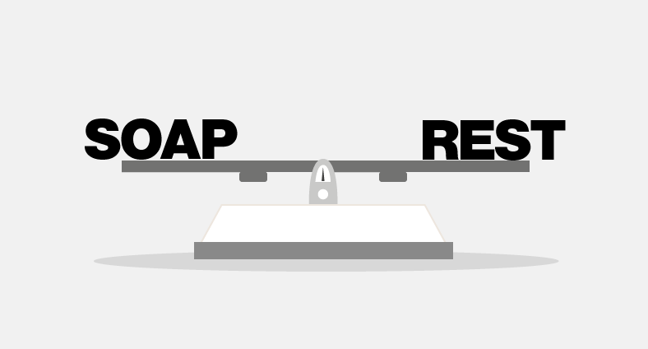

Slide 8
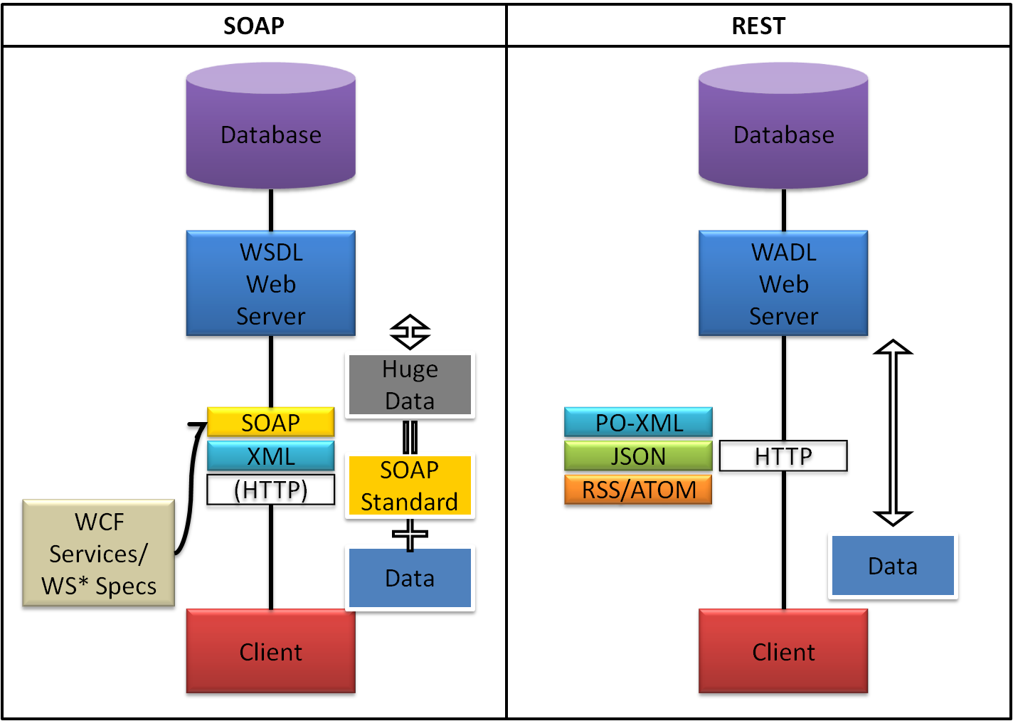

Slide 9
Not to be confused
For interview:
Web Service = Rest or SOAP
Web API =RESTful (HTTP based) web service.
Also have different forms-
SOAP came 1st than Rest, so people think web service testing means SOAP.
Web Service =SOAP+WSDL (+HTTP or SMTP or JMS..).
Typically RESTful web services != Web Services (WSDL,SOAP) but
RESTful Web services (with uppercase 'W') that means RESTful+WSDL+SOAP..

Slide 10
Points | REST | SOAP
Abbreviation | Representational State Transfer architecture | Simple Object Access Protocol
Based on | Architecture | Protocol
Application-Language and platform | independent | independent
Testing language/data format | JSON or XML/YAML | Only XML
Performance | Faster performance and scalability | Slower than rest and not so scalable
Cashable or save in browser | Get operation can be cashed or save to browser history | Not possible to cash or save to browser history
Security and reliability | Less | High (financial company use mostly soap)
Transfer protocol | HTTP | Many- HTTP,SMTP,FTP,JMS
Specification | JAX-RS | JAX-WS
Massage size | Light weight –no extra xml markup | Heavy- has SOAP specific markup

Slide 11
WSDL
Web service define language.
Both SOAP or REST used WSDL server
But only WSDL means a file written in XML
This file only used in SOAP to communicate between client and server

Slide 12
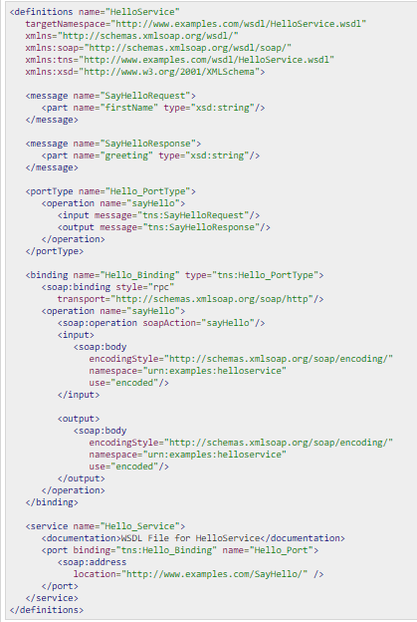
WSDL file

Slide 13
WSDL is like Xml contains :
Definitions : HelloService
Type : Using built-in data types and they are defined in XMLSchema.
Message :
sayHelloRequest : firstName parameter
sayHelloresponse: greeting return value
Port Type : sayHello operation that consists of a request and a response service.
Binding : Direction to use the SOAP HTTP transport protocol.
Service : Service available at http://www.examples.com/SayHello/
Port : Associates the binding with the URI http://www.examples.com/SayHello/ where the running service can be accessed.

Slide 14

Hypertext Transfer Protocol (HTTP)
HTTP is the protocol to exchange or transfer hypertext.
HTTP functions as a request–response protocol in the client–server computing model.

Slide 15
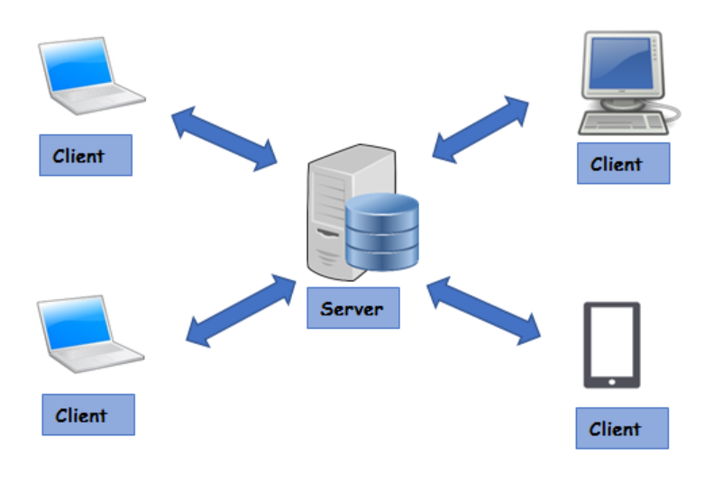

Slide 16
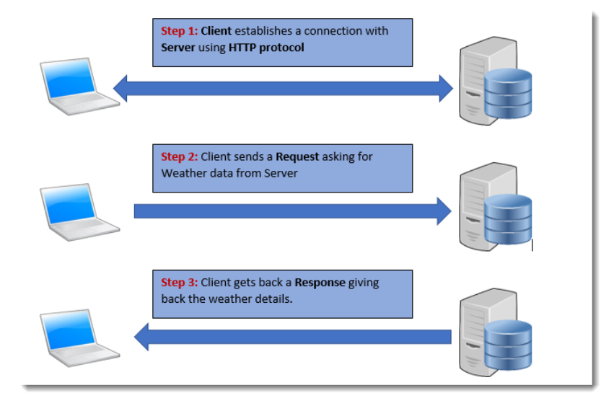

Slide 17
HTTP Request
HTTP Request is a packet of Information that one computer sends to another computer to communicate something.
An HTTP Request contains following parts
Request Line
Headers, 0 or more Headers in the request
An optional Body of the Request

Slide 18
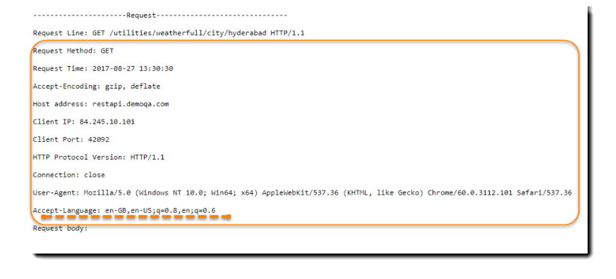
Put below URL in browser
http://restapi.demoqa.com/utilities/weatherfull/city/hyderabad

Slide 19
Request Body
Request Body is the part of the HTTP Request where additional content can be sent to the server.
In the current example we haven’t sent a body in the request to the server.
This can be seen by an empty Request Body section.

Slide 20
HTTP Response
Just like HTTP Request, HTTP Response also has the same structure:
Status Line
Headers, 0 or more Headers in the request
An optional Body of the Request

Slide 21
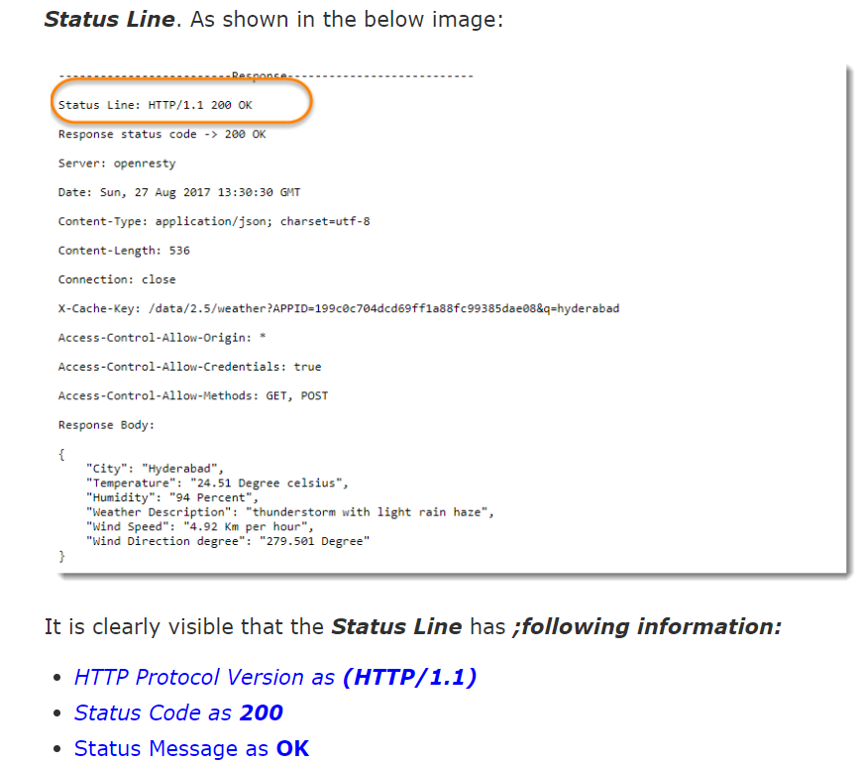
Response Status Line
A Status Line consists of three parts:
HTTP Protocol Version
Status Code
Reason Phrase

Slide 22
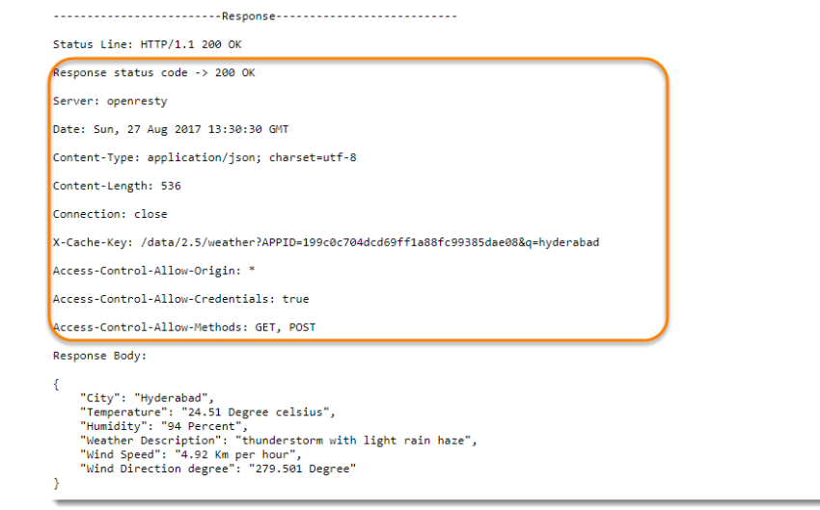
Response Header

Slide 23
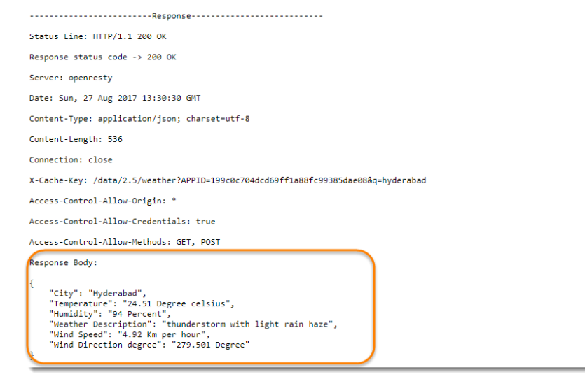
Response body

Slide 24
HTTP Methods
A standard SQLstatement, HTTP method (this is typically used to build RESTful APIs^{[4]}) or DDS operation:
Operation | SQL | HTTP | DDS
Create | INSERT | PUT/ POST | write
Update (Modify) | UPDATE | POST / PUT/ PATCH | write
Read (Retrieve) | SELECT | GET | read / take
Delete (Destroy) | DELETE | DELETE | dispose
CURD

Slide 25
HTTP Request Methods
GET | POST
Requests data from a specified resource | Submits data to be processed to a specified resource
sent in the URL of a GET request /test/demo_form.asp?name1=value1&name2=value2 | is sent in the HTTP message body of a POST request(POST /test/demo_form.asp HTTP/1.1)
GET requests can be cached | POST requests are never cached
GET requests remain in the browser history | POST requests do not remain in the browser history
GET requests can be bookmarked | POST requests cannot be bookmarked
GET requests have length restrictions the GET method adds the data to the URL; and the length of a URL is limited (maximum URL length is 2048 characters) | POST requests have no restrictions on data length
never be used when dealing with sensitive data

Slide 26
Other HTTP Request Methods
Method | Description
HEAD | Same as GET but returns only HTTP headers and no document body
PUT | Uploads a representation of the specified URI
DELETE | Deletes the specified resource
OPTIONS | Returns the HTTP methods that the server supports
CONNECT | Converts the request connection to a transparent TCP/IP tunnel

Slide 27
HTTP status code – to understand pass or fail reasons
S.N. | Code and Description
1 | 1xx: Informational It means the request has been received and the process is continuing.
2 | 2xx: Success It means the action was successfully received, understood, and accepted.
3 | 3xx: RedirectionIt means further action must be taken in order to complete the request.
4 | 4xx: Client Error It means the request contains incorrect syntax or cannot be fulfilled.
5 | 5xx: Server Error It means the server failed to fulfill an apparently valid request.

Slide 28
The most common codes to use for any HTTP request are: 200 – OK 404 – Not found 500 – Internal Server Error

Slide 29
One can then expand to a more detailed set of statuses if required, such as: 201 – Created 204 – No Content 304 – Modified 400 – Bad Request 401 – Unauthorized 403 – Forbidden 501 – Not Implemented

Slide 30
API Testing With JAVA

Slide 31
API
Application programing interface.
Many types(some open source)
Remote APIs
Remote APIs allow developers to manipulate remote resources through protocols, specific standards for communication that allow different
technologies to work together, regardless of language or platform.
Web APIs
Web APIs are the defined interfaces through which interactions happen between a client and applications that use its assets.

Slide 32
API is typically defined as a set of Hypertext Transfer Protocol (HTTP) request messages, which is usually in
an Extensible Markup Language (XML) or
JavaScript Object Notation (JSON) format.
While "web API" historically has been virtually synonymous for web service,
Note: The recent trend (so-called Web 2.0) has been moving away from Simple Object Access Protocol (SOAP) based web services and service-oriented architecture (SOA)=>>>>>>>>>> towards more direct representational state transfer (REST) style web resources and resource-oriented architecture (ROA).

Slide 33
Web Service: | Web API:
1)It is SOAP based service and return data in XML form. | 1)Web API is HTTP based service and by default it return data in JSON or XML form.
2)It supports HTTP protocol or others- SMTP | 2)It supports HTTP protocol.
3)It can be hosted only on IIS. | 3)It can be hosted with in the application or IIS
4)It is not open source but can be consumed by any client that understands XML. | 4)It is open source and it can be consumed by any client that understands JSON or XML
5) Example: SOAP or REST web service | 5) Example: RESTful API

Slide 34
Web service Vs API
All Web services are APIs but all APIs are not Web services.
Web services might not perform all the operations that an API would perform.
A Web service uses only three styles of use: SOAP, REST and XML-RPC for communication whereas API may use any style for communication.
A Web service always needs a network for its operation whereas an API doesn’t need a network for its operation.
An API facilitates interfacing directly with an application

Slide 35
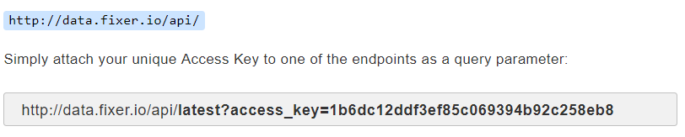
For API testing URL
To see all weather API -https://openweathermap.org/api
To see all currency - https://fixer.io/
Go both site and registration for login>>> to get API id
Others :
http://restapi.demoqa.com/utilities/weather/city
https://www.youtube.com/watch?v=AbJrfP4ziIk&list=PLEiBaBxmVLi-hoi61aX-2agQb8EXSCT5f&index=1

Slide 36
APK or API id
Create new or use my ID
Weather APK :: 25e4fc6e6b2e357a177262c7005
Currency APK:: 1b6dc12ddf3ef85c069394b92c258eb8

Slide 37
http://samples.openweathermap.org/data/2.5/weather
Parameter:
?
q=London,uk
&
appid=b1b15e88fa797225412429c1c50c122a1

Slide 38
Full URL=APK
APK mean API keys = URL+ Parameter+ id
APK= http://samples.openweathermap.org/data/2.5/weather?q=London,uk&appid=25e4fc6e6b2e357a177262c7005

Slide 39
Examples of API calls
JSON URL:: api.openweathermap.org/data/2.5/weather?q=London
XML URL:: api.openweathermap.org/data/2.5/weather?q=London&mode=xml
HTML URL:: api.openweathermap.org/data/2.5/weather?q=London&mode=html

Slide 40
Add JARS in new maven project
Rest-assuared JAR
<dependency>
<groupId>io.rest-assured</groupId>
<artifactId>rest-assured</artifactId>
<version>3.0.2</version>
</dependency>
2. Selenium- java JAR
3. TestNG/ Junit JAR

Slide 41
Import
Need to write before class name
import static io.restassured.RestAssured.*;
import static org.hamcrest.Matchers.*;
Static as no need to create object

Slide 42
HTTP status code
public class Start {
@Test
public void start() {
Response data= get("https://samples.openweathermap.org/data/2.5/weather?q=newyork,us&appid=25e4fc6e6b2e357a177262c7005.json");
System.out.println(data.statusCode());
}
}

Slide 43
Status code validation
if(data.statusCode() == 200) {
System.out.println("Test passed::"+data.statusCode());
}
else {
System.out.println("test failed");
}
Assert.assertEquals(data.statusCode(), 200);
}

Slide 44
BDD format API code
public class Start3 {
@Test
public void start3(){
given().get("https://samples.openweathermap.org/data/2.5/weather?q=newyork,us&appid=25e4fc6e6b2e357a177262c7005")
.then().statusCode(200);
}
}

Slide 45
JSON
What is JSON?- it’s a webserver language , xml also webserver language
JSON stands for JavaScript Object Notation
JSON is a syntax for storing and exchanging data.
JSON is text, written with JavaScript object notation.
JSON is a lightweight data-interchange format
JSON is "self-describing" and easy to understand
JSON is language independent *

Slide 46
Why use JSON?
Since the JSON format is text only,
it can easily be sent to and from a server- transfer data
used as a data format by any programming language.
JavaScript has a built in function to convert a string, written in JSON format, into native JavaScript objects: JSON.parse()

Slide 47
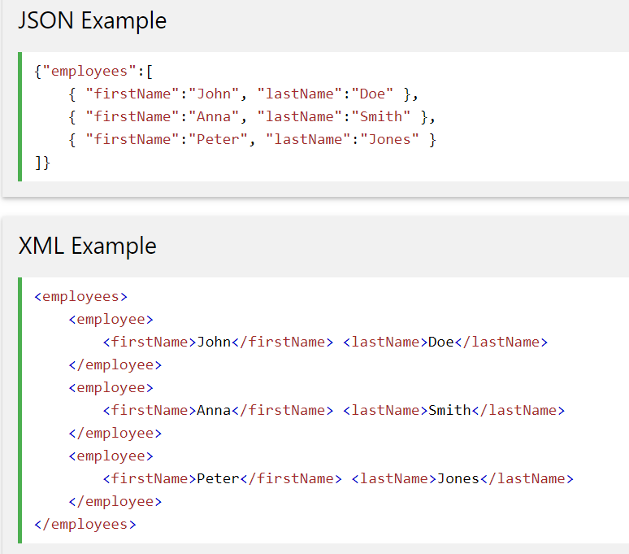
JSON vs XML

Slide 48
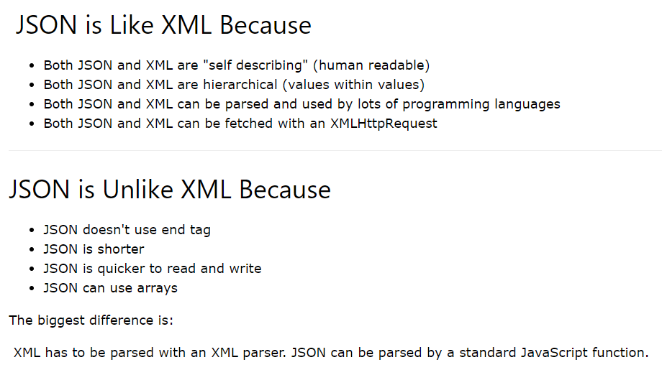
JSON vs XML

Slide 49
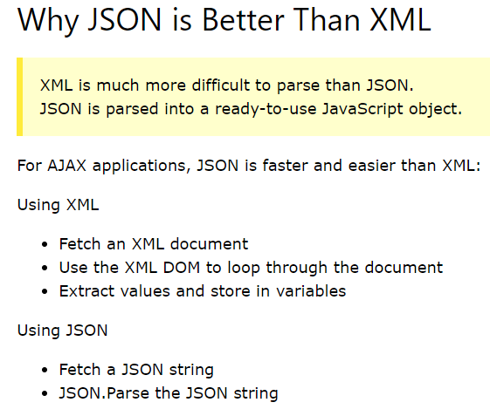
JSON vs XML

Slide 50
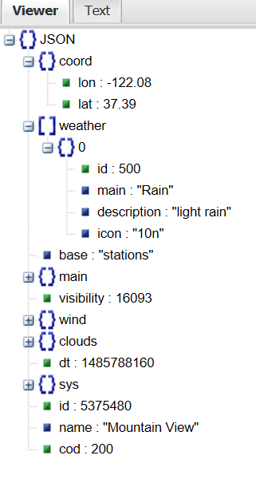
Read json
Open Online -JSON viewer
URL to browser https://samples.openweathermap.org/data/2.5/weather?q=newyork,us&appid=25e4fc6e6b2e357a177262c7005
Open browser http://jsonviewer.stack.hu/
Copy and paste weather data in to json viewer

Slide 51
Print in response or data
public class Start5 {
@Test
public void start() {
Response data= get("https://samples.openweathermap.org/data/2.5/weather?q=newyork,us&appid=25e4fc6e6b2e357a177262c7005.json");
System.out.println(data.asString());// jason as strin
System.out.println(data.prettyPrint());// json but it will print twice
}
}

Slide 52
Response in BDD style
public class Start5{
@Test
public void start3(){
given().get("https://samples.openweathermap.org/data/2.5/weather?q=newyork,us&appid=25e4fc6e6b2e357a177262c7005")
.then().statusCode(200).log().all();
}
}

Slide 53
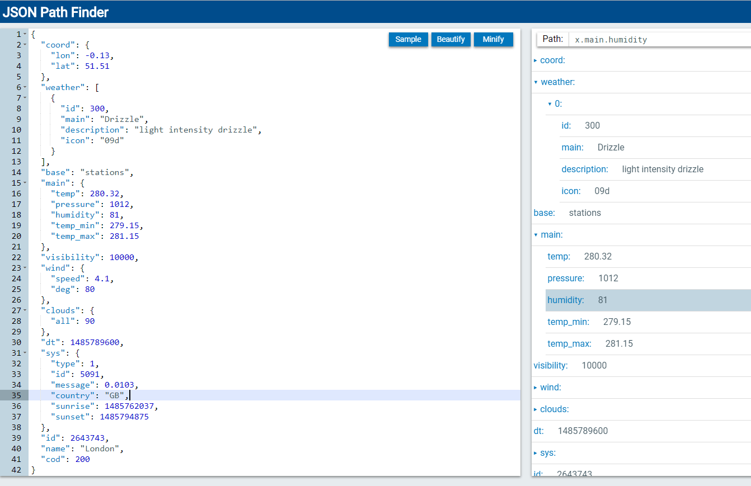
JSON path
Like xpath to find specific object from JSON file
Use : http://jsonpathfinder.com/

Slide 54
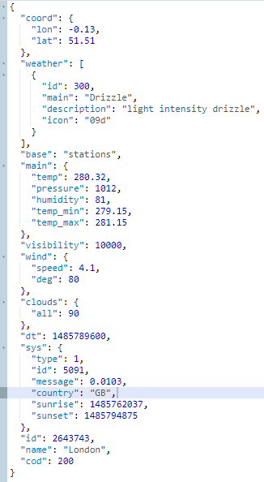
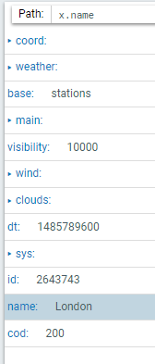
Json path

Slide 55
Read path from code
public class Start6 {
@Test
public void start() {
Response data= get("https://samples.openweathermap.org/data/2.5/weather?q=newyork,us&appid=25e4fc6e6b2e357a177262c7005.json");
JsonPath jsonPathEvaluator = data.jsonPath();
String city = jsonPathEvaluator.get("name");
System.err.println("City received from Response ::" + city);
}
}
Console output:: City received from Response ::London

Slide 56
BDD format path
public class Start7 {
@Test
public void start3(){
given(). when().get("https://samples.openweathermap.org/data/2.5/weather?q=newyork,us&appid=25e4fc6e6b2e357a177262c7005")
.then().body("name",equalTo( "London"));
}
}

Slide 57
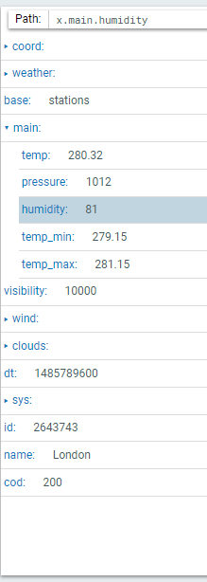
Humidity

Slide 58
Simple Code
public class Start71 {
@Test
public void start() {
Response data= get("https://samples.openweathermap.org/data/2.5/weather?q=newyork,us&appid=25e4fc6e6b2e357a177262c7005.json");
JsonPath jsonPathEvaluator = data.jsonPath();
int humidity= jsonPathEvaluator.get("main.humidity");
System.err.println("Humidity received from Response ::" + humidity);
}
}
Console output:: Humidity received from Response ::81

Slide 59
BDD format
public class Start8 {
@Test
public void start3(){
given(). when().get("https://samples.openweathermap.org/data/2.5/weather?q=newyork,us&appid=25e4fc6e6b2e357a177262c7005")
.then().body("main.humidity",equalTo(81));
}
}

Slide 60
Practice more
http://toolsqa.com/rest-assured/read-response-body-using-rest-assured/
http://toolsqa.com/rest-assured/what-is-jsonpath-and-how-to-query-jsonpath/
https://www.youtube.com/watch?v=AbJrfP4ziIk&list=PLEiBaBxmVLi-hoi61aX-2agQb8EXSCT5f&index=1

Slide 61
THANKS

